Slide 1
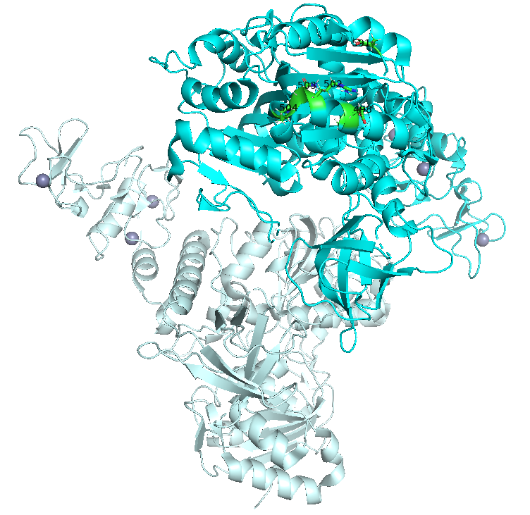
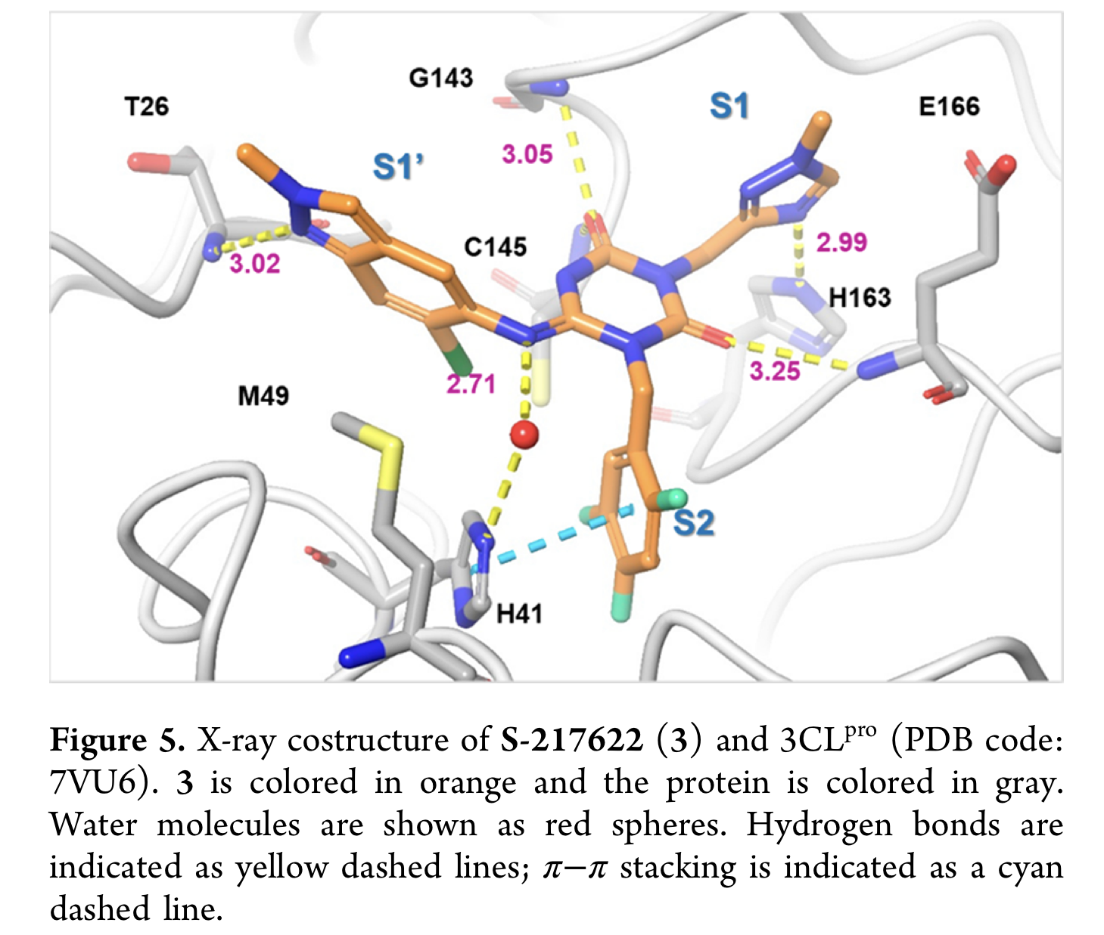
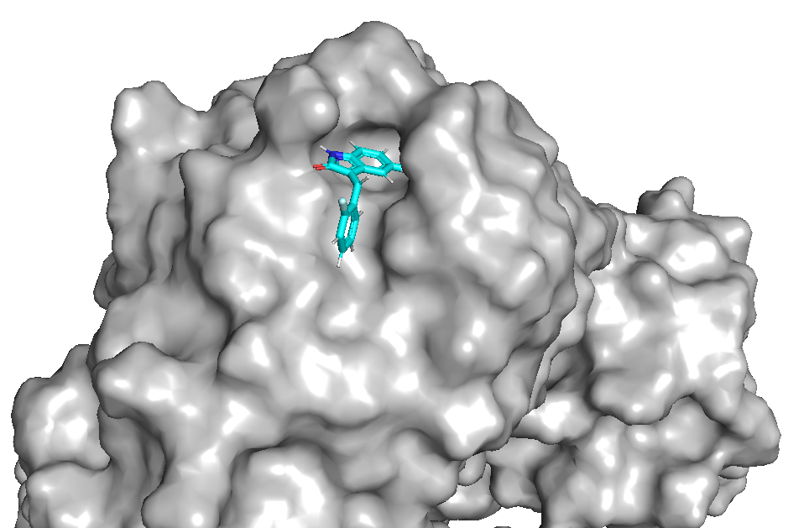
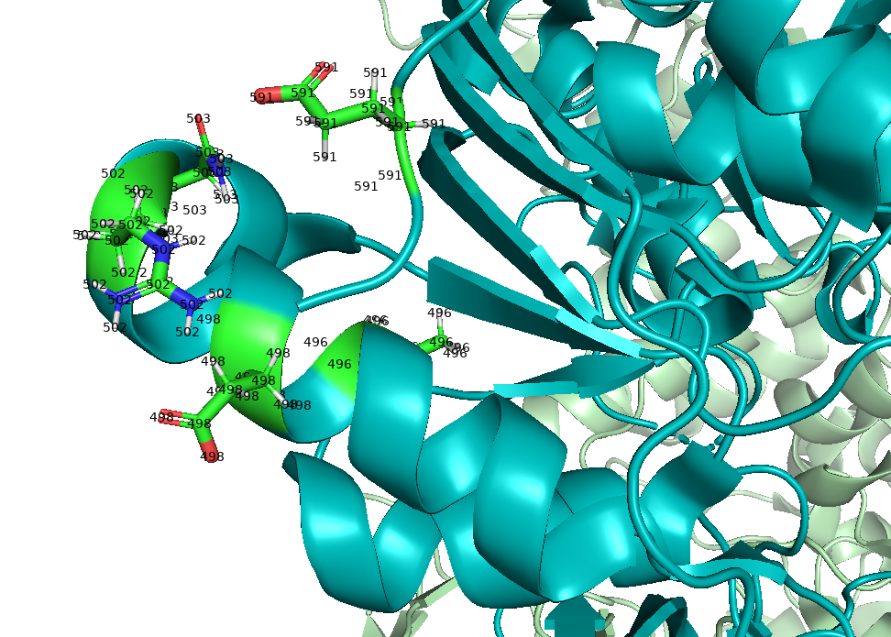
Tom Knight, PhD Student (Medicinal Chemistry)
Prof. Matthew Todd Research Group
Department of Pharmaceutical and Biological Chemistry
UCL School of Pharmacy
Drug Discovery Journal Club
Monday 9th May 2022

Slide 2
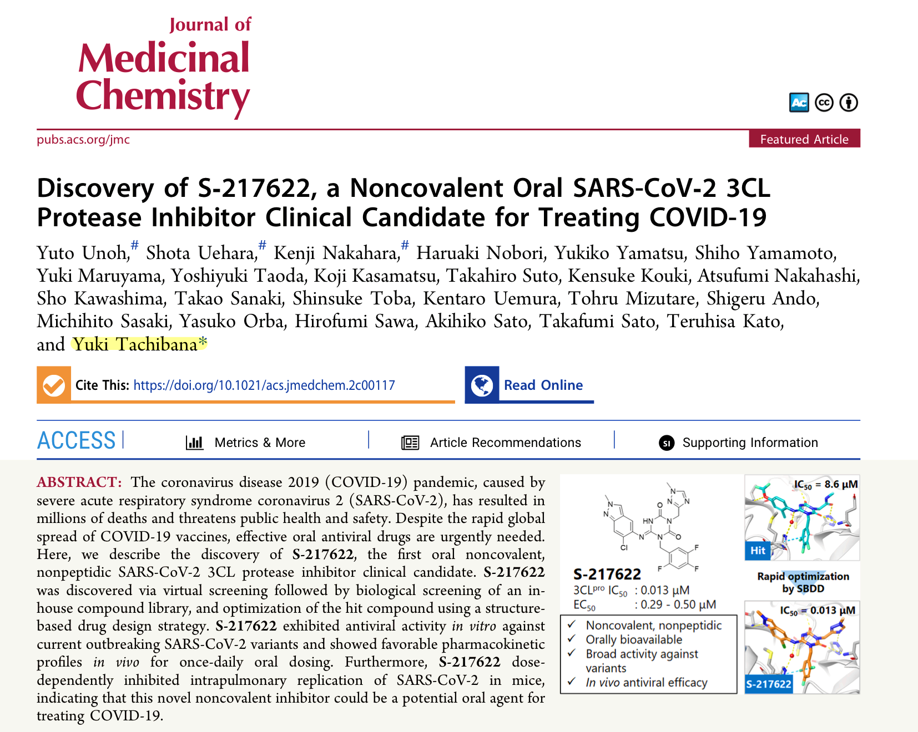
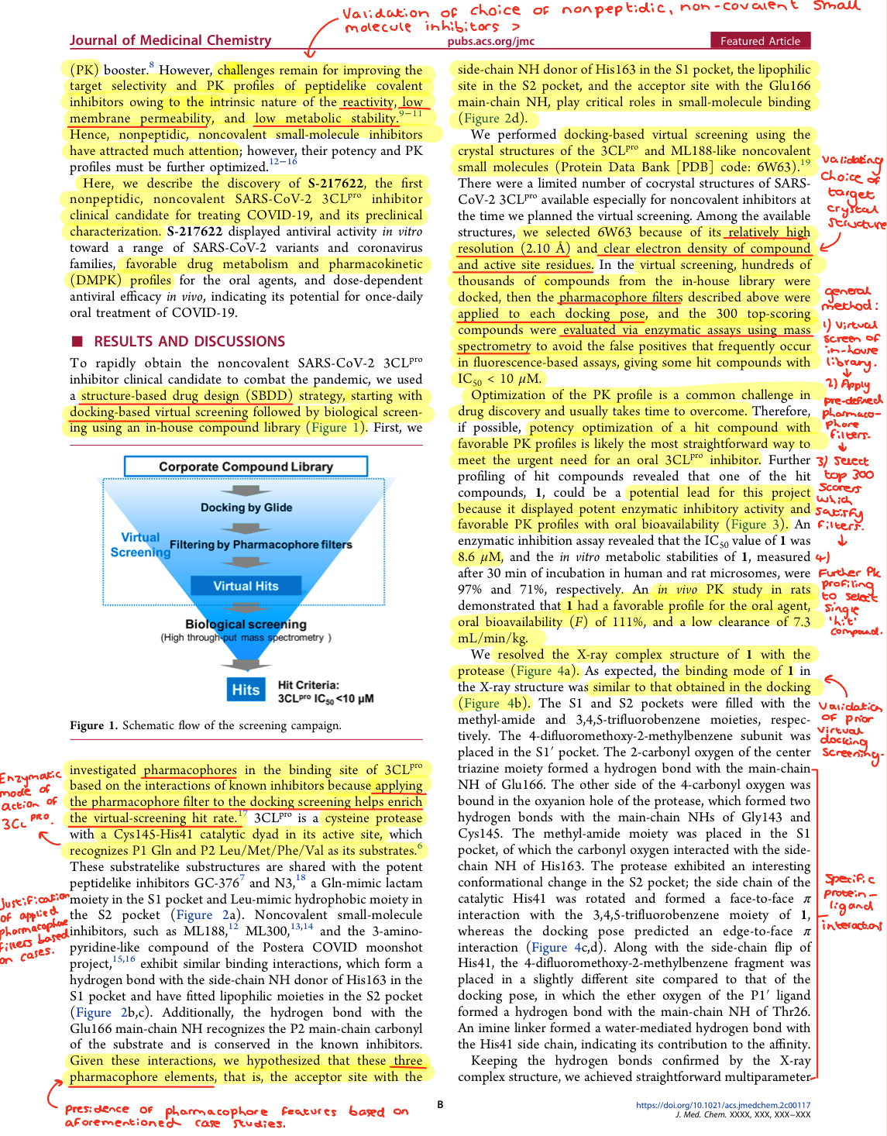
Highlights:
Structure-Based Drug Design (SBDD) campaign gave S-217622, a noncovalent ‘broad’ SARS-CoV-2 3CL protease inhibitor that is now in clinical trials.
Investigated pharmacophores in the binding site of 3CLpro based on interactions of known inhibitors.
Applying the pharmacophore filter to the docking screen helps enrich the virtual screening hit rate.
S-217622 displayed broad antiviral activities against a range of coronaviruses (SARS-CoV, SARS-CoV 2 various strains, MERS CoV) suggesting possible applications of this compound or its derivatives for the next pandemic caused by future emerging coronaviruses.
S-217622 showed no inhibitory activity against host-cell proteases, such as caspase-2, chymotrypsin, cathepsin B/D/G/L, and thrombin at up to 100 μM, suggesting its high selectivity for coronavirus proteases.

Slide 3
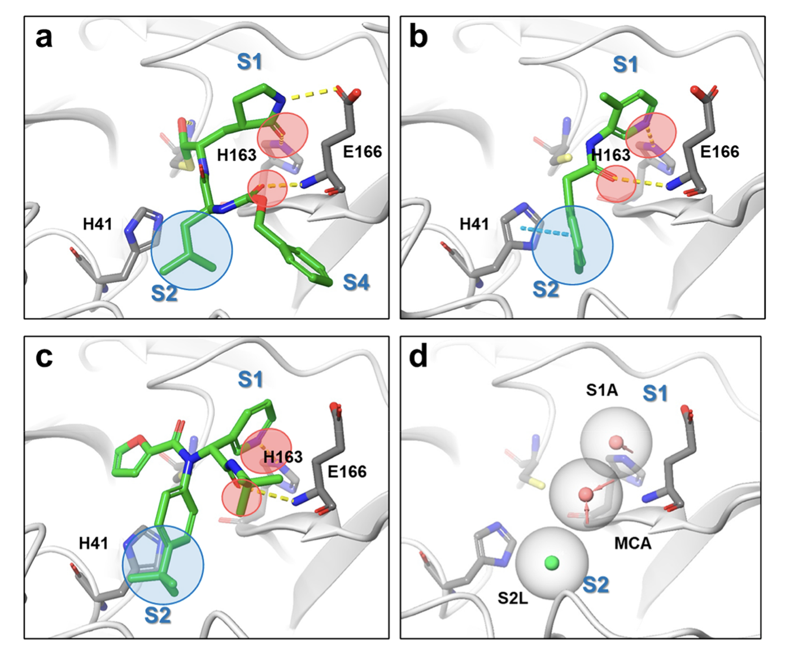
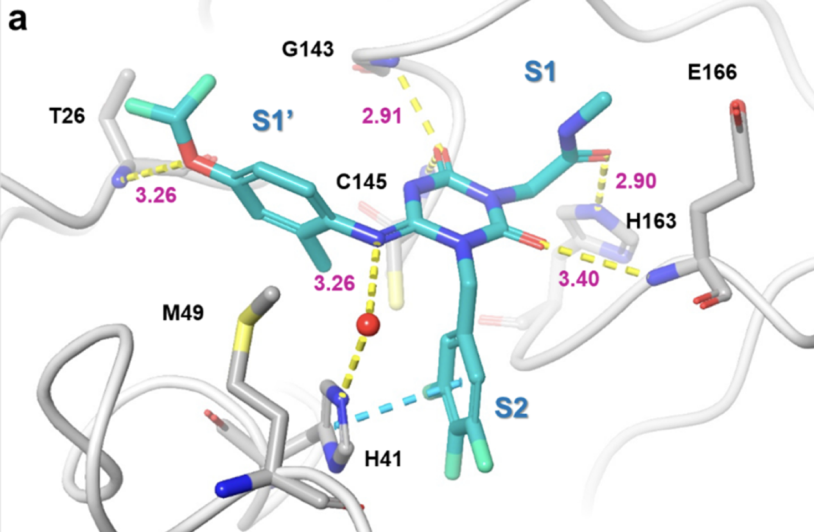
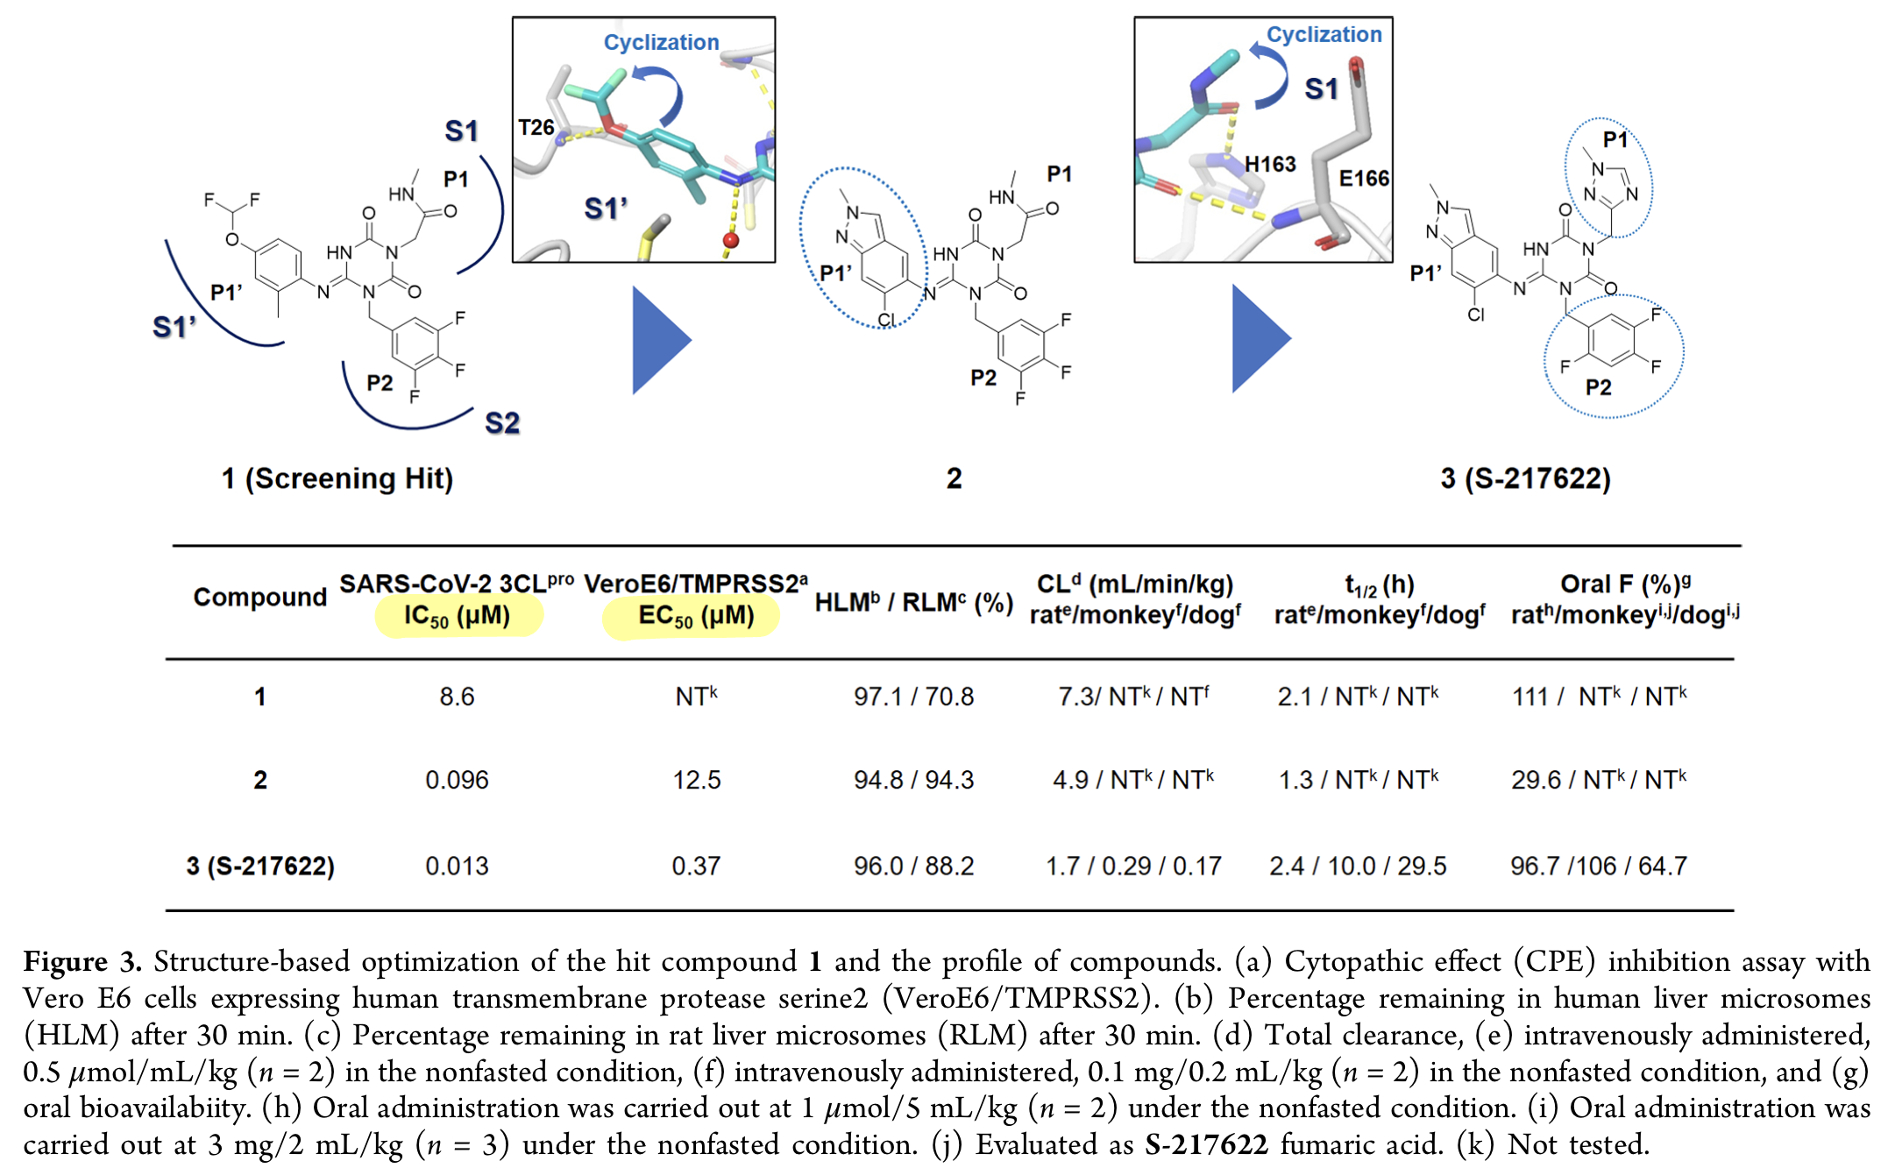
Hit Finding
A crystal structure of the SARS-CoV-2 3CLpro in a complex with a known non-covalent inhibitor was from PDB (PDB code: 6W63).
Structure was prepared using Protein Preparation Wizard and Epic.
In-house compound library was pre-processed by Ligprep before docking.
Virtual screening was performed via Glide using using Schrodinger Drug Discovery Suite 2019-4.
The generated docking poses were filtered by the predefined pharmacophore using Phase.
The pharmacophores were set as the acceptor sites with the side-chain NH of His163 in the S1 pocket, the lipophilic site in the S2 pocket, and the acceptor site with the Glu166 main-chain NH.
The 300 top-scoring compounds that matched all pharmacophores were selected for enzymatic assays.
Further pharmacokinetic (PK) profiling of hit compounds revealed that one of the hit compounds, 1, could be a potential lead for this project because it displayed potent enzymatic inhibitory activity and favourable PK profiles with oral bioavailability (Figure 3).
An enzymatic inhibition assay revealed that the IC50 value of 1 was 8.6 μM.

Slide 4
Structure-Based Hit-To-Lead Campaign: 1 to 3
Structure-based optimisation of hit 1 increased potency 661-fold to give 3 (S-217622), with an IC50 of 0.013 μM.
Switching the P1’ ligand to 6-chloro-2-methyl-2H-indazole allowed the hydrogen bond with Thr26 whilst allowing a better fit with the S1’ pocket, giving a 90-fold improvement in enzymatic inhibitory activity (IC50) whilst maintaining a favourable DMPK profile.
Next, the P1 methyl-amide moiety was replaced with a triazole (common amide bioisostere), yielding compound 3, which became clinical candidate S-217622, showing a biochemical activity of IC50 = 0.013 μM, and antiviral activity of EC50 = 0.37 μM, and preferable DMPK profiles for oral dosing (e.g. high metabolic stability, high oral absorption, and low clearance in rats, and even better results in dogs and monkeys.
The high oral bioavailability suggests 3s potential use for once-daily oral treatment of COVID-19 without requiring a PK booster (e.g. ritonavir, as with PF-07321332).
Notes:
Figure 5 shows the X-ray cocrystal structure of 3CLpro complexed with S-217622. In the S1 site, the 1-methyl-1H- 1,2,4-triazole unit fit to the S1 pocket, forming a hydrogen bond with the side-chain NH of His163. The distinctive His41 flip observed in 1 was maintained in the S-217622 complex, and the 2,4,5-trifluorobenzylic moiety occupied the hydro- phobic S2 pocket and stacked with the side chain of His41. The P1′ ligand, 6-chloro-2-methyl-2H-indazole moiety, held hydrogen bonding with the Thr26 main-chain NH and hydrophobic contact with Met49 as seen in the cocrystal structure of 1.

Slide 5
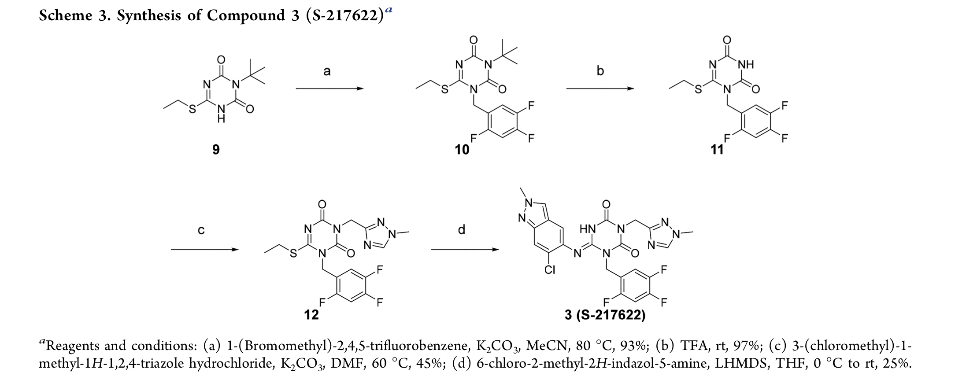
Medicinal Chemistry
Starting from known compound 9, SN2-type N-alkylation with corresponding Bromo-reagent gave 10 in 92% yield.
The N-t-Butyl group was removed (deprotection) with TFA affording 11 in 97% yield (good regioselectivity).
A second SN2-type N-alkylation with the Chloro-reagent allowed the 1,2,4-triazole unit to be introduced, yielding 12 in 45% yield. *Why? (Conjugation, selectivity?)
Substitution of the SEt moiety with the 5-aminoindazole unit with base (LHMDS) by a Nucleophilic Acyl Substitution Reaction gave 3 (25% yield). *Why?

Slide 6
Terminology
Pharmacophore : ”The precise arrangement of atoms, groups, or functionalities in a small molecule required for specific interactions with its biological target and its activity” OR “A pharmacophore is the ensemble of steric and electronic features that is necessary to ensure the optimal supramolecular interactions with a specific biological target structure and to trigger (or to block) its biological response.”A pharmacophore does not represent a real molecule or a real association of functional groups, but a purely abstract concept that accounts for the common molecular interaction capacities of a group of compounds towards their target structure.
IC50 : The half maximal inhibitory concentration (IC50) is a measure of the potency of a substance in inhibiting a specific biological or biochemical function. IC50 is a quantitative measure that indicates how much of a particular inhibitory substance (e.g. drug) is needed to inhibit, in vitro, a given biological process or biological component by 50%.
EC50 : the concentration of a drug, antibody or toxicant which induces a response halfway between the baseline and maximum after a specified exposure time. More simply, EC50 can be defined as the concentration required to obtain a 50% [...] effect.
DMPK parameters : Distribution,/Drug Metabolism and Pharmacokinetics (DMPK), involve studies designed to determine the absorption and distribution of an administered drug, the rate at which a drug takes effect, the duration a drug maintains its effects, and what happens to the drug after being metabolized by the body. DMPK properties will help validate the toxicology studies, support safety evaluations prior to the first dose in humans, provide human dosimetry data for the clinic, and indicate the likelihood of drug-drug interactions.
Virtual screening/docking : a computational technique used in drug discovery to search libraries of small molecules in order to identify those structures which are most likely to bind to a drug target, typically a protein receptor or enzyme. VS has largely been a numbers game focusing on searching the enormous chemical space of over 10^60 conceivable compounds.
Hit-to-lead :(H2L) also known as lead generation is a stage in early drug discovery where small molecule hits from a high throughput screen (HTS) or other screening approaches are evaluated and undergo limited optimization to identify promising lead compounds. These lead compounds undergo more extensive optimization in a subsequent step of drug discovery called lead optimization (LO).
Structure-Based Drug Design relies on knowledge of the three-dimensional structure of the biological target obtained through methods such as x-ray crystallography or NMR spectroscopy. If an experimental structure of a target is not available, it may be possible to create a homology model of the target based on the experimental structure of a related protein. Using the structure of the biological target, candidate drugs that are predicted to bind with high affinity and selectivity to the target may be designed using interactive graphics and the intuition of a medicinal chemist. Alternatively various automated computational procedures may be used to suggest new drug candidates

